Slide 1



Authentication and Authorization

Slide 2
Objectives
Define and describe authentication
Explain and describe how to implement authentication
Define and describe ASP.NET Identity
Define and describe the process of authorization

Slide 3
Authentication
Authentication is the process of validating the identity of a user before granting access to a restricted resource in an application.
When the application receives a request from users, it tries to authenticate the user.
Typically, authentication allows identifying an individual based on the user name and password provided by the user.

Slide 4
Authentication Modes
Three types of authentication modes:
Forms authentication
Windows authentication
OpenID/OAuth

Slide 5
Forms Authentication
ASP.NET MVC application does not automatically uses any type of authentication by default.
Following code snippet shows the default <authentication> element in the Web.config file:
<system.web>
<authentication mode="None" />
</system.web>
To use Forms authentication mode, change the mode attribute of the <authentication> element to Forms.
<system.web>
<authentication mode="Forms" />
</system.web>

Slide 6
Windows Authentication
Best suited to an intranet environment where a set of known users are already logged on to a network.
The firewall that takes care of the authentication process.
Uses the users credential authenticated by the company’s firewall for security checks.

Slide 7
Open Authentication/OpenID
Using the credentials for third party authentication providers, such as Google, Twitter, Facebook, and Microsoft.
Third party authentication providers need to be configured.
Modify Startup.Auth.cs file in App_Start folder.

Slide 8
Using the Authorize Attribute
Authorize attribute is added on the BuyItem() to secure action method
[Authorize]
public ActionResult BuyItem()
{
return View();
}

Slide 9
Securing a Controller
Authorize attribute can be used to a controller to secure the entire controller.
[Authorize]
public class ProductController : Controller
{
…
}
The code will restricts all the action methods defined in the ProductController controller class.

Slide 10
Unsecuring a Controller
Use AllowAnonymous attribute on action methods if not want to to secure them
[AllowAnonymous]
public ActionResult Index()
{
return View();
}
Access to this method does not require authentication.

Slide 11
Securing the Application
To make all users to be authenticated for an entire application, add the Authorize attribute as a global filter in the RegisterGlobalFilters() method in the FilterConfig.cs file.
public static void RegisterGlobalFilters (GlobalFilterCollection filters)
{
filters.Add(new System.Web.Mvc.AuthorizeAttribute()); filters.Add(new HandleErrorAttribute());
}
AllowAnonymous attribute can be used to allow access to specific controllers or action methods.

Slide 12
ASP.NET Identity
ASP.NET MVC 5 uses ASP.NET Identity, which is a new membership system for ASP.NET MVC applications.
You can use ASP.NET Identity to add login features to your application.
ASP.NET Identity uses the Code First approach to persist user information in a database.
Identity and Account management classes are automatically added to the project.

Slide 13
IdentityModel
IdentityModel.cs file:
namespace WebApplication1.Models {
public class ApplicationUser : IdentityUser {
}
public class ApplicationDbContext : IdentityDbContext<ApplicationUser>
{
public ApplicationDbContext()
: base("DefaultConnection")
{
}
}
}

Slide 14
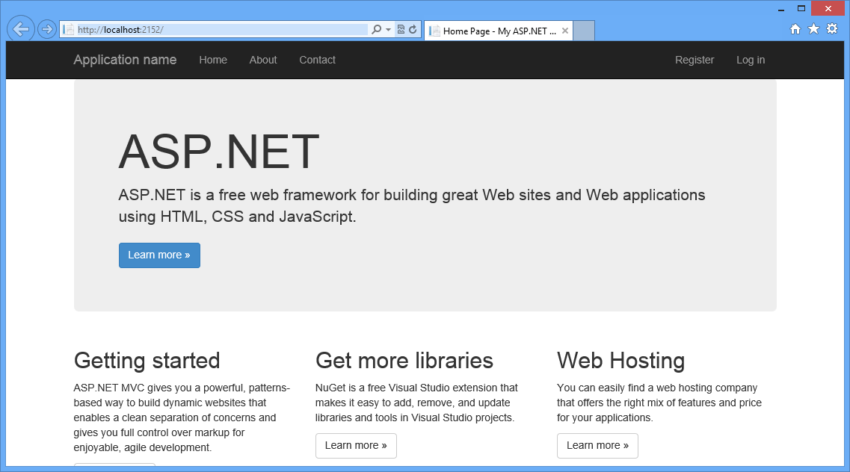
Home page

Slide 15
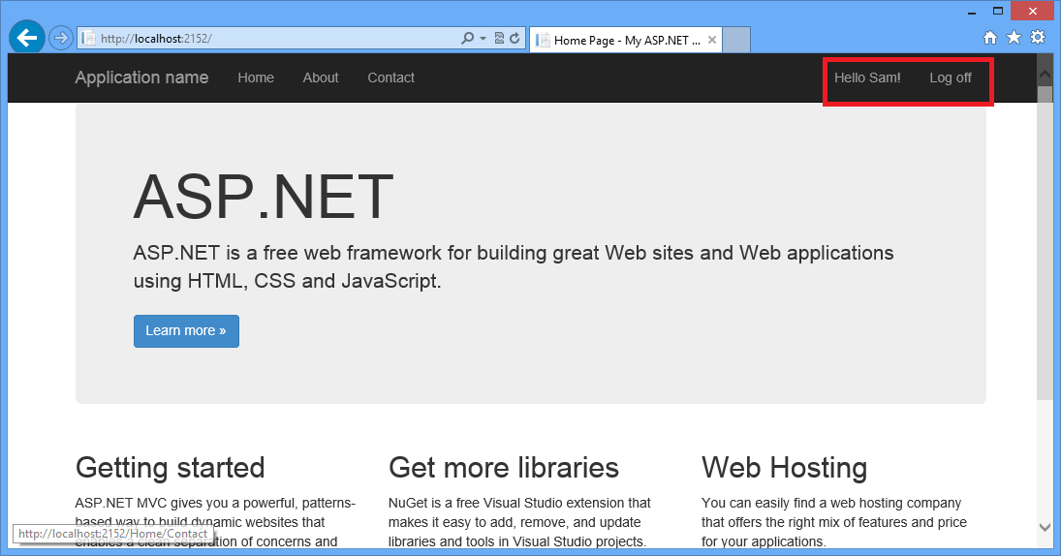
Register & Login

Slide 16
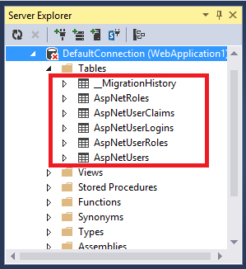
Identity Tables

Slide 17
Authorization
Authorization is the process of verifying whether an authenticated user has the privilege to access a requested resource.
After creating users that can access your application by using the membership management service, you need to specify authorization rules for the users.
You need to grant different permissions to different users to provide accessibility to the pages on your application.

Slide 18
User Authentication
Users are in a group user known as roles and have different permissions.
Users and roles are defined by using the Authorize attribute.
[Authorize(Users="Mathews, Jones")]
public class ManagerProduct: Controller
{
// Code to perform some operation
}

Slide 19
Role Authentication
Authorization at the role level:
[Authorize(Roles="Administrator")]
public class ManagerProduct: Controller
{
// Code to perform some operation
}

Slide 20
Combined Authentication
Combination of role and user authentication
[Authorize(Roles="Manager", Users="Steve, Mathews")]
public class ManagerProduct: Controller
{
// Code to perform some operation
}

Slide 21
Role Providers
You need to create roles so that you can assign specific rights to specific users.
Some of different role providers of MVC 5:
ActiveDirectoryRoleProvider: This provider class enables you to manage role information for an application in the Active Directory.
SqlRoleProvider: This provider class enables you manage role information for an application in SQL database.
SimpleRoleProvider: This role provider works with different versions of SQL Server.
UniversalProviders: This provider works with any database that Entity Framework supports.

Slide 22
Provider property
Use to to access the current role provider.
var roles = (TestRoleProvider)Roles.Provider;
Only work when the System.Web.Security namespace is included.

Slide 23
Create Roles
Create roles by using the Seed() method:
var roles = (SimpleRoleProvider)Roles.Provider;
if (!roles.RoleExists("Administrator"))
{
roles.CreateRole("Administrator");
}

Slide 24
Add users to Role
Add users to that role
if (!roles.GetRolesForUser("Mark_Jones").
Contains("administrator"))
{
roles.AddUsersToRoles(new[] { "Mark_Jones" },
new[] { "administrator"});
}

Slide 25
Authorize a Role
Use the Authorize attribute
[Authorize(Roles = "administrator")]
public ActionResult ManageProduct()
{
return View();
}

Slide 26
Enable link to a role
Use the ActionLink() method to show/hide the link for users.
@if(User.IsInRole("administrator"))
{
@Html.ActionLink("ManageProduct","ManageProduct")
}

